Slide 1





THE HUMAN SERVICES
COSTING & PRICING
RESOURCE PACKAGE
Training Video 2: Costing & Pricing Governance
Professor David Gilchrist,
Director, UWA Centre for Public Value

Slide 2



The Training Videos
Video 1 – Introduction
Video 2 – Costing & Pricing Governance
Video 3 – Costing & Pricing Principles
Video 4 – The MS Excel Costing Models
Video 5 – Costing & Government Procurement Training Video

Slide 3
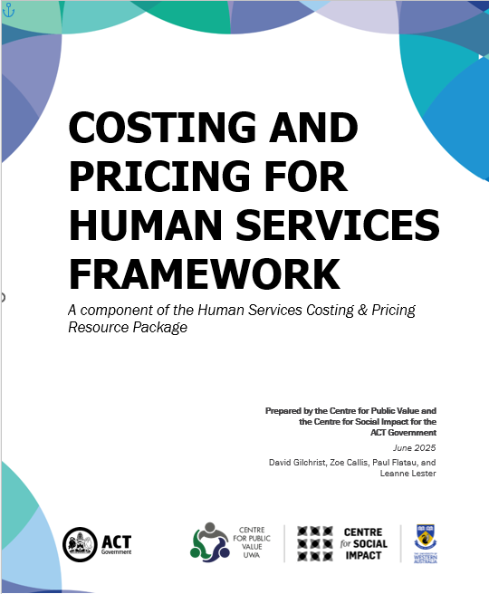
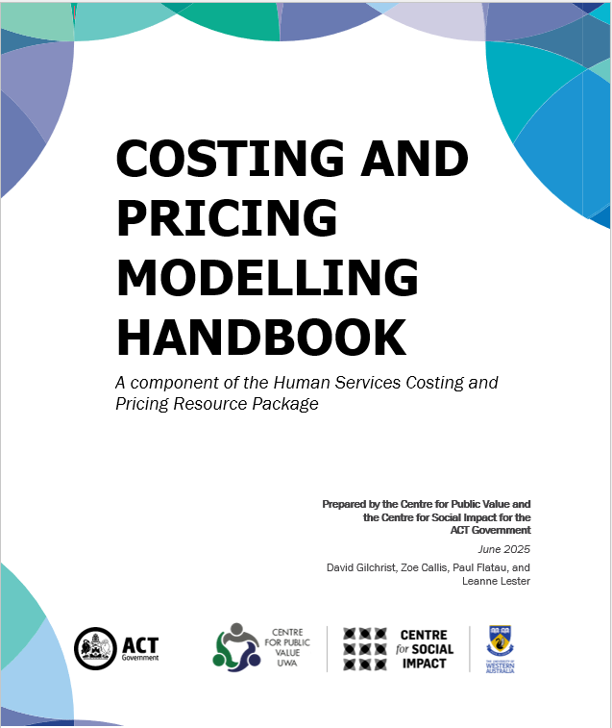
Agenda
Sustainability
Purpose of Costing & Pricing
Cost/Benefit Considerations
Rewards & Risks of Costing and Pricing
The Relevant Range
Key Governance Considerations

Slide 4
Context
Board has limited capacity in relation to setting prices and achieving profit outcomes
Board has the ultimate responsibility for the sustainability of the organisation
The more the board knows about the financial performance and financial capacity of their organisation, the more ability they have to respond to external pressures and control their environment
Ultimately, the decision as to whether to continue doing something or not lies with the board
Ultimately, the board must decide whether it is financially sustainable to agree to a contract price

Slide 5
Sustainability
FW 8
FW 40
Quantity of Services
Quality of Services
Timing of Services
↓ in these elements equals ↓ in sustainability
Importantly, reductions in sustainability
can be the first signs of insolvency
Any organisation must make a profit to be
sustainable in a market economy

Slide 6
Sustainability (cont.)
FW 8
Short Term
Mid Term
Longer Term
Solvency
Having the cash to pay your bills when they are due.
Stability
Being able to continue to provide services that meet the quantity, quality, and timing required in accordance with your organisation’s mission.
Sustainability
Being able to replace assets and invest in your organisation to meet changing circumstances and ensure it remains fit-for-purpose in the context of pursuing your organisation’s mission in the long term.
e.g., Cash flow / working capital
e.g., Employee Entitlements
e.g., Assets Replacement

Slide 7
Purpose of Costing & Pricing
FW 22
To ensure you understand the comprehensive cost of service delivery
To establish a target price for your services and supports
To compare your targeted price with the price offered by funders (Governments, Philanthropists)
To make a decision as to whether you are comfortable contracting to deliver under that offered price having identified the gap between what you need and what you are offered.

Slide 8
Pricing & Profit
FW 38
FW 44
HB 19
Any organisation operating in a market economy must make a profit, even if it is a charity
Mark-up: financial needs in the short-, medium- and longer-terms
Develop a three-to-five-year financial plan
Calculate the Target Price – the price you need to charge in order to ensure financial sustainability into the longer-term
Acknowledging that the Target Price is unlikely to be achieved

Slide 9

Reconciling Your Costing With Funders’ Pricing
FW 7
HB 36
Target Price
Price required in order to ensure sustainability (Result of Costing & Pricing Process)
Achieved Price
Price actually provided by funder
Target Price Gap
The difference between the Target Price and the Achieved Price (Excess of cost and mark-up or selling at less than cost)
LESS

Slide 10
Cost/Benefit Considerations
FW 22
When embarking on a costing and pricing exercise, we want to be as accurate as possible. However, accuracy comes at a cost and so the Cost – Benefit Consideration needs to be thought about.
That is, will the cost in time and money be outweighed by the value of the information developed?

Slide 11
Rewards of Costing & Pricing
FW 22
Rewards:
  Increased understanding
  Better communication within organisation
  Better decision Making
  Better risk analysis
  Better mission focus
Greater Sustainability

Slide 12
Risks of Costing & Pricing
FW 23
Risks:
  Based on history BUT a prediction
  Activity expectations unfounded
  Activity timing mis-predicted
  Environmental effects impact outcomes
Timely Reporting

Slide 13
Relevant Range
FW 43
All of these ideas are only applicable within the Relevant Range
As activity volume changes, it may be that both variable and fixed costs also change
Economies and Diseconomies of Scale
Tactical & Strategic Accounting Decision Making

Slide 14
Relevant Range (cont.)
FW 8
One more client might require…
Fixed Costs
Increased Management
Increased rent/leasing costs
Increased staffing ratios
More motor vehicles
Relevant Range
Relevant Range
$
Relevant Range
Activity level

Slide 15
Key Governance Considerations
HB 21
Proportionate Response – Objects and Strategy Priorities
Board Reporting Requirements – Re-evaluate the types of information, format and priorities in board reporting
Activity delineation – cost recovery and key alarm trigger points
Board Engagement – getting to know your business
Integrated Approach – three to five-year strategic plan + three to five-year financial plan + annual budget (capital and operating)
  Control is essential to this process
    Board engagement
    Reporting – both internal and external
    Continuous Forecasting
    Admitting errors

Slide 16
Control Considerations
HB 21
Board role:
  Ultimately Responsible
  Source of reasonableness checking
  Should set parameters and policies
  Should receive reports providing the actual cost recovery versus planned or targeted
Financial control
  Regular review of margin being achieved against target
  Regular review of effects of under-recovery
  Regular review of likely future increases previously unidentified
  Development of reporting and mitigation strategies

Slide 17
Control Considerations (cont.)
HB 21
Reporting:
  Costing Assumptions
  Activity Expectations
  Actual v Expected – activities AND dollars
  Appropriate breakdown of activity expectation time periods
  Decisions points – when is activity not being realised and the board needs to know?

Slide 18
Decision Making Principles
HB 18
Always seek to be consistent in calculations
Start with history and move forward
Seek to establish true cost within the bounds of usefulness and benefit
Identify your assumptions and let board members know what they are
Always check for reasonableness and errors / omissions
Always get a second opinion
Focus on the material costs and programs
Get outside advice if you feel uncomfortable about what you are doing
Cost based on likely ACTUAL level of activity NOT capacity.

Slide 19
Thank you!
Professor David Gilchrist david.gilchrist@uwa.edu.au
Professor Paul Flatau paul.flatau@uwa.edu.au
UWA Centre for Public Value Website:
https://www.uwa.edu.au/schools/Research/Centre-for-Public-Value
Centre for Social Impact UWA Website:
https://www.uwa.edu.au/schools/research/UWA-Centre-for-Social-Impact

