Slide 1





THE HUMAN SERVICES
COSTING & PRICING
RESOURCE PACKAGE
Training Video 4:
The MS Excel Costing Models
Professor David Gilchrist,
Director, UWA Centre for Public Value

Slide 2



The Training Videos
Video 1 – Introduction
Video 2 – Costing & Pricing Governance
Video 3 – Costing & Pricing Principles
Video 4 – The MS Excel Costing Models
Video 5 – Costing & Government Procurement Training Video

Slide 3
Navigating the Videos
Start at the very beginning & watch in order
Read the Framework document prior to watching videos 3 & 4
The videos include navigation markers to help connect the training with the outputs:
Reference to Framework page 20
Reference to Handbook page 20
FW 20
HB 20

Slide 4
Agenda
Some Key Issues
The Models – An Overview
Governance

Slide 5
Some Key Issues
MS Excel Spreadsheets:
  The Service Provider Costing & Pricing Model – to cost and price all activities for one year (Service Provider)
  The Single Product Costing & Pricing Model – to cost and price a single activity with multi-year capacity (Single Product)
System needs: Microsoft Excel 2010 compatibility minimum
Within each model, sheets are interconnected – you enter data and the calculations are undertaken automatically

Slide 6
The Models – An Overview
HB 23
Uniform Elements:
  Structure:
    Key_Data
    People, Property, Vehicles, Direct_OH
    Program_Pricing, Accommodation_Pricing, Health_Professionals_Pricing
Optional, won’t be needed for all organisations

Slide 7
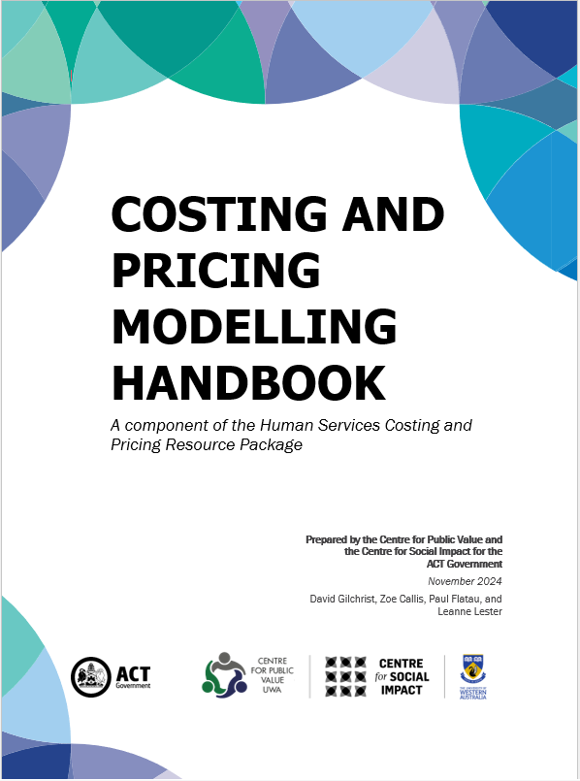
The Models – An Overview (cont.)
HB 24
Model-Specific Elements:
  Service Provider:
    Indirect_OH
    Client_Pricing_Calculator
    Cost_Summary
    Funding_Sources
    Funding_Summary
  Single Product:
    Capital_Purchases
    Multiyear_Pricing
Step-by-step explainer in the Handbook

Slide 8

The Models – An Overview (cont..)
HB 24
Conventions Sheet:
  Noted in each model
  The cells that are editable are coloured and described on this sheet:
  = Manual data entry = Select from the dropdown menu = Administration use only
  Any cells that are not editable are not intended to be changed:
= Formula = Model build only
  Data Integrity Checks: ERROR

Slide 9
The Models – An Overview (cont…)
HB 25
HB 38
Information
  Corporate Information
Version_Control
Key_Data:
  Make decisions regarding key assumptions and core data
  Payroll Information
  Service Names and Information (ensure the names used are recognisable)

Slide 10


The Models – Governance
HB 21
Save an Original Version – set aside the original version you download and ensure it is safe from misuse
Spreadsheet Integrity – Ensure formulae are not changed in Original Version
Version Control – Ensure version information section is complete
Version Control – Establish naming protocol (e.g., alpha for draft, numeric for final)
Complete Notes – describe what you have done in each version to ensure others can understand what has been done

Slide 11
The Models – Governance (cont.)
HB 21
What-if Scenario Building – ensure you are able to attribute the changed results to modifications made.
  A good way to do this is to change only one item on each scenario and review the results then return to original position before changing another element. Always document what has been changed.
Regular Calculation Testing

Slide 12
The Models – What they don’t do
HB 21
Remember, you must still determine:
What costs are to be included
What percentage of those costs need to be allocated to which programs
You must interpret the information provided in the Client Price Calculator, the Cost Summary and the Funding Summary sheets.
The quality of the information going into the models determines the quality of information coming out – the models cannot amend/identify errors.

Slide 13
Thank you!
Professor David Gilchrist david.gilchrist@uwa.edu.au
Professor Paul Flatau paul.flatau@uwa.edu.au
UWA Centre for Public Value Website:
https://www.uwa.edu.au/schools/Research/Centre-for-Public-Value
Centre for Social Impact UWA Website:
https://www.uwa.edu.au/schools/research/UWA-Centre-for-Social-Impact

