Slide 1





THE HUMAN SERVICES
COSTING & PRICING
RESOURCE PACKAGE
Training Video 5:
Costing & Government Procurement
Professor David Gilchrist,
Director, UWA Centre for Public Value

Slide 2



Agenda
Brief Project Overview
Brief Overview of the Principles of Sustainability
Why should this worry government?
How can government contribute to sustainability?
Some General Comments

Slide 3
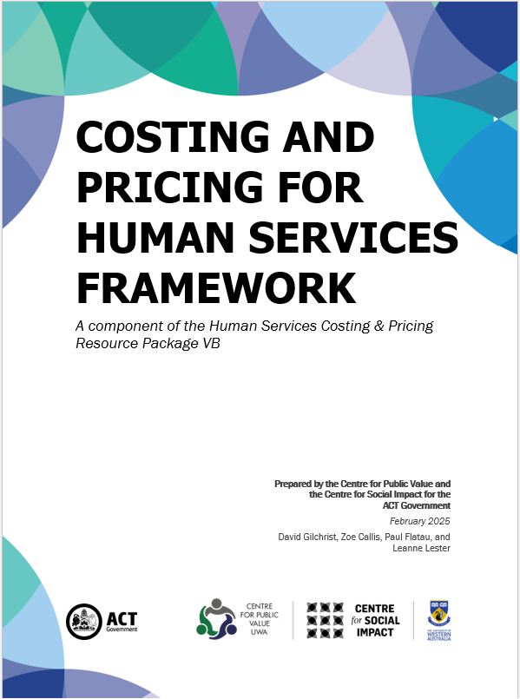
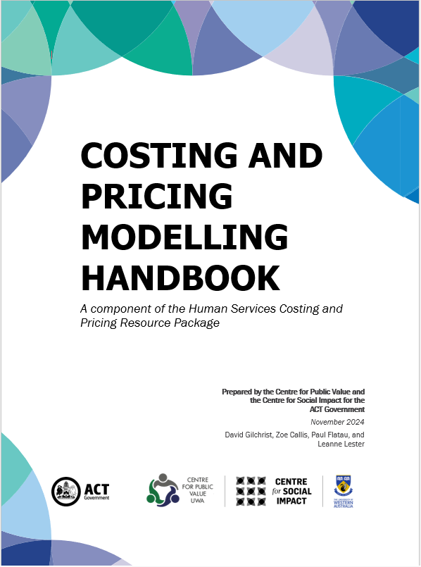
Brief Project Overview
UWA Centre for Public Value
Centre for Social Impact UWA
Significant background in undertaking similar projects nationally and sub-nationally:
  Costing & Pricing
  Indexation
  Tool Creation

Slide 4
The Project Context
Funded by the ACT Government
Challenge to sustainability is ever increasing at a systemic and organisational level
Historical under-funding across all governments and all times so that underinvestment is embedded
The first step in rectifying this issue is to properly cost the delivery of services
This requires an understanding of costing processes and what constitutes the quality, quantity and timing requirements of sustainability.
SPRC Report 2021 Counting the Costs: Sustainable funding for the ACT community services sector and ACT Government Response 2023

Slide 5
The Project Principles
Governments and Human Services Providers all want a sustainable human services sector
Governments and Human Services Providers want public funds to be efficiently and effectively used in the interests of the entire community
Tools need to be fit-for-purpose
Collaboration between Governments, Human Service Providers and Philanthropists is a critical element in ensuring the long-term sustainability of Human Services delivery
Using the same language for costing & pricing is critical to developing understanding between all parties

Slide 6
The Project Outputs
Costing and Pricing for Human Services Framework
The Service Provider Costing & Pricing Model (an MS Excel Spreadsheet Tool – to cost the organisation)
The Single Product Costing & Pricing Model (an MS Excel Spreadsheet Tool – to cost a particular program)
Costing & Pricing Modelling Handbook
The Costing & Pricing Provider Training Videos (4 Videos)
The Costing & Pricing Government Procurement Training Video

Slide 7
Relevance to Funders
It is important that technical proficiency is developed by both funders and human services providers.
The Human Services Costing & Pricing Resource Package is an important tool for funders to better understand the components involved in service delivery.
Funders require sufficient financial literacy to evaluate funding applications and ensure services are adequately funded.
The Resource Package aims to establish a shared language between funders and providers including terminology (i.e., the glossary) associated with costing and pricing that is consistent with accounting practice.
Human services providers need to be financially sustainable to meet community demand.

Slide 8
Brief Overview:
Principles of Sustainability
Sustainability: what is it and why is it important?
  Systemic perspective: Service Mix & Service Mix Gap
  Capacity retention
  Skills and experience retention
  Innovation and up-scaling for better outcomes
  Policy capacity
  Service reliability
  Policy outcomes achievement
  Cheap ≠ Efficient
A human services sector
that is not financially sustainable
costs taxpayers more

Slide 9
Brief Overview:
Principles of Sustainability (cont.)
FW 8
Provider sustainability:
  Policy scaling capacity
  Innovation/Investment
  Recruitment and retention
  Asset replacement
  Service capacity to meet need
  Shock impact survival
Short Term
Mid Term
Longer Term
Solvency
Having the cash to pay your bills when they are due.
Stability
Being able to continue to provide services that meet the quantity, quality, and timing required in accordance with your organisation’s mission.
Sustainability
Being able to replace assets and invest in your organisation to meet changing circumstances and ensure it remains fit-for-purpose in the context of pursuing your organisation’s mission in the long term.
e.g., Cash flow /
working capital
e.g., Employee Entitlements
e.g., Assets Replacement

Slide 10
Brief Overview:
Principles of Sustainability (cont..)
Provider sustainability:
  Profitability
  Balance Sheet capacity
  All costs met, including accounting estimates such as depreciation
  Indexation appropriately calculated

Slide 11
Why should this worry government?
Service and policy capacity sustainability
Cost shifting and inefficiency
Political impact and budget impact of sudden service capacity decline

Slide 12
How Can Government Contribute to Sustainability?
Realign funding with change in comprehensive cost over time
Maintain capacity to meet policy change/innovate
Annual response to cost experience
Challenges
5 Yearly comprehensive tenders
Capital injections
Indexation model
System sustainability
Responses
Informs budget outyears captures real cost
Informs policy framework assessment
Informs budget maintains sector capacity
Outcomes

Slide 13
It’s all about compromise…
The real world requires compromise by all
Understanding the financial sustainability challenges improves capacity for compromise
Over time, transparency of the comprehensive cost of service delivery will improve understanding, efficiency, reliability and effectiveness

Slide 14
Thank you!
Professor David Gilchrist david.gilchrist@uwa.edu.au
Professor Paul Flatau paul.flatau@uwa.edu.au
UWA Centre for Public Value Website:
https://www.uwa.edu.au/schools/Research/Centre-for-Public-Value
Centre for Social Impact UWA Website:
https://www.uwa.edu.au/schools/research/UWA-Centre-for-Social-Impact

