Slide 1
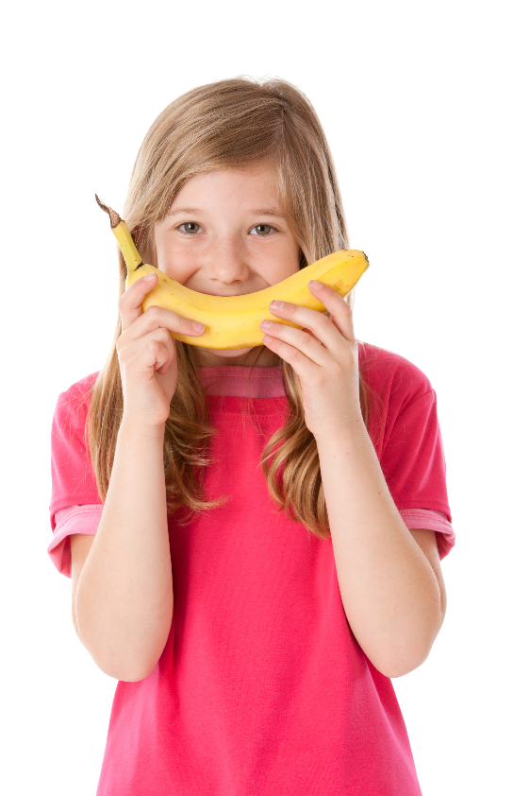
We’re a
Fresh Tastes
school
Our school promotes healthy food and drinks
Notes:
Note to presenter: Ensure you have copies of the My healthy lunchbox flyer
Our school is taking part in Fresh Tastes which means we encourage and promote healthy food and drinks across our school including in our canteen (if applicable), during school events, for fundraising and student lunchboxes.
OPTIONAL: If you have a food and drink policy at your school, this would be an ideal time to let the parents know. It’s important to set the scene so parents know what your school’s expectations are.

Slide 2
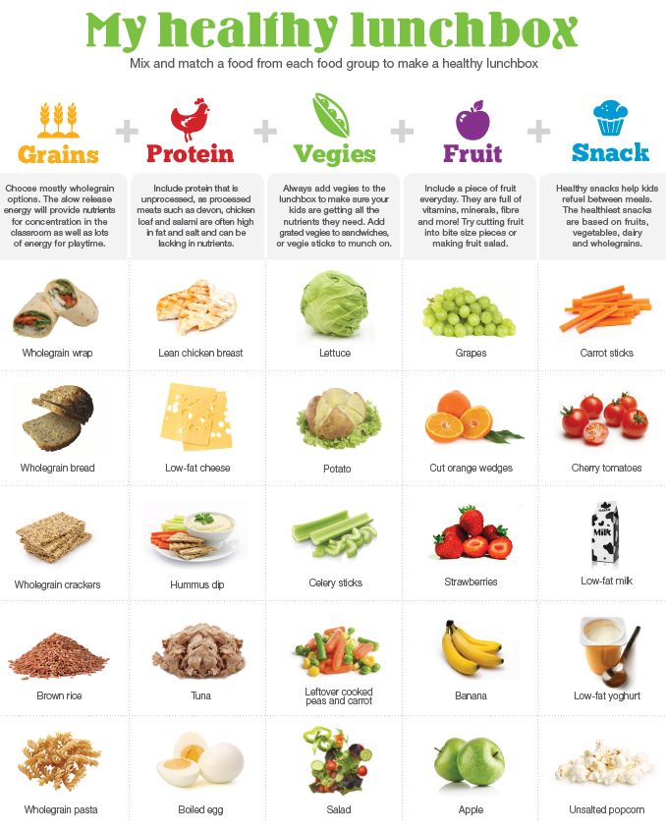
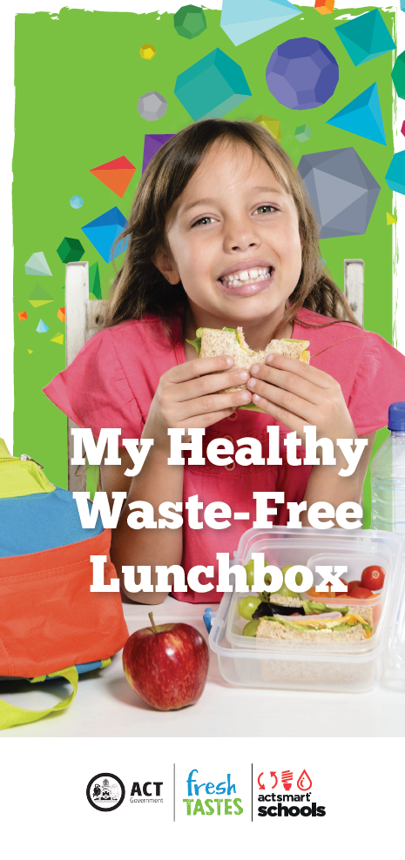
My healthy lunchbox
Make sure you get a ‘My Healthy Waste-free Lunchbox’ Flyer!
Notes:
We know it can be tricky to pack a lunchbox that has all the nutrients your kids need to get through the day at school so here’s a handy guide to help you.
You can find this guide in the My Healthy Lunchbox flyer in your orientation packs OR you can pick up a flyer from XXX.
Kids who have healthier lunchboxes can have better concentration in the classroom which can help with their learning.

Slide 3
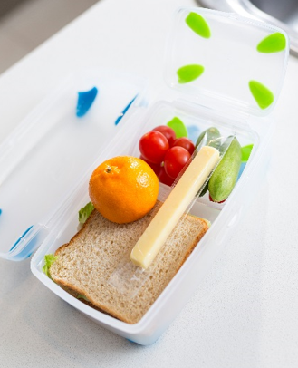
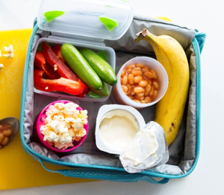
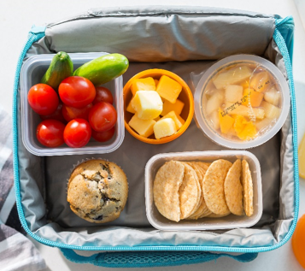
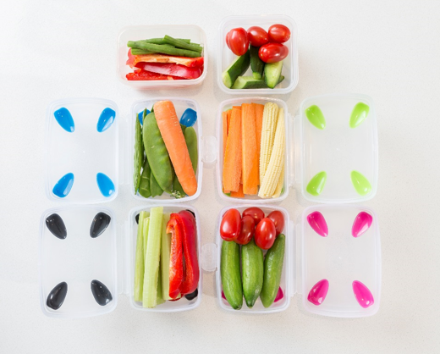
Lunchbox ideas
Don’t forget to pack something for vegie and fruit break!
Notes:
Here’s some examples of what a healthy lunchbox could look like.
Our school does waste-free lunchbox days on XXX and we hope you can support us by trying to pack as little waste as possible on those days.
Small reusable snack containers such as these here are a great way to store food in lunchboxes to reduce waste
Don’t forget to pack something for your child to eat during vegie and fruit break everyday.

Slide 4
Watch what Canberra’s little experts have to say about making healthy choices. They’ll make you LOL!
“I still don’t get what pork is.”
“It’s a type of chicken I think… but it’s from a lamb”
www.act.gov.au/freshtastes ‘Lunchbox’ section
Notes:
Here’s a short funny video where kids tell us what they really think about lunchboxes and fresh food.
For more lunchbox tips and information about Fresh Tastes you can visit the ‘Parents section’ of their website.

