Slide 1





THE HUMAN SERVICES
COSTING & PRICING
RESOURCE PACKAGE
Training Video 3: The Nature of Costing
Professor David Gilchrist,
Director, UWA Centre for Public Value

Slide 2
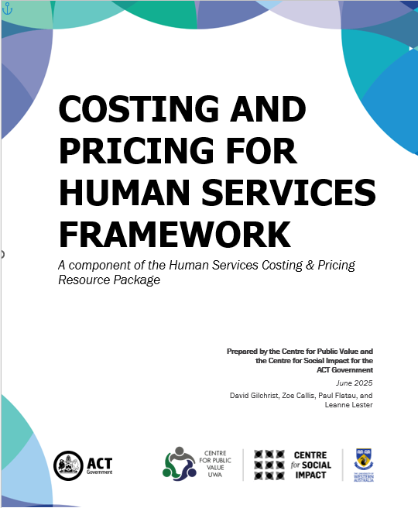
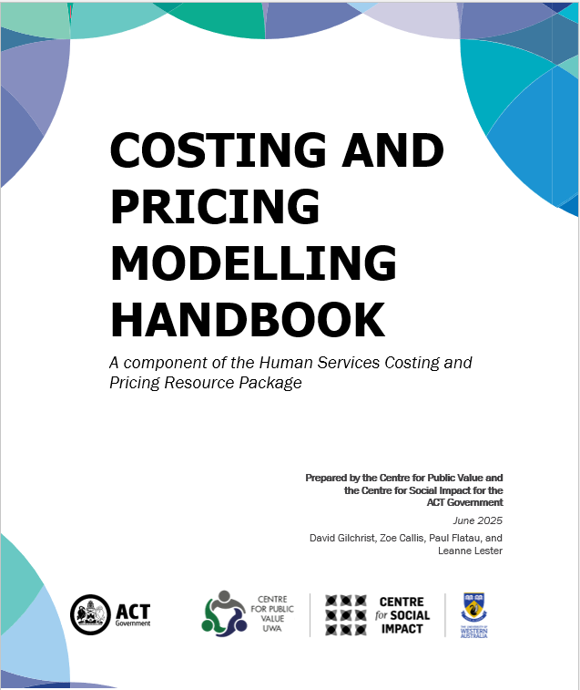



The Training Videos
Video 1 – Introduction
Video 2 – Costing & Pricing Governance
Video 3 – Costing & Pricing Principles
Video 4 – The MS Excel Costing Models
Video 5 – Costing & Government Procurement Training Video

Slide 3
Navigating the Videos
Start at the very beginning & watch in order
Read the Framework document prior to watching videos 3 & 4
The videos include navigation markers to help connect the training with the outputs:
Reference to Framework page 20
Reference to Handbook page 20
FW 20
HB 20

Slide 4
Agenda
General Principles
Our Approach
Specific Costing Practice
Types of Costs
Initial Questions to Ask

Slide 5
General Principles
FW 27
HB 18
Poor financial outcomes impede an organisation in achieving its mission
Funders do not calculate their funding offering based on your costs
Costing is intended to assist organisations to determine their Target Price Gap
Need to cost based on the adopted theory of change – how you are going to achieve your mission

Slide 6
General Principles (cont.)
FW 27
FW 30
HB 18
To arrive at a comprehensive cost, the organisation must predict:
  Volume Level: how many services of each type
  Timing of Service: in the year, month, day
  Cost Levels: types of costs and how much they are likely to be
  Cost Timing: when will costs be incurred? Paid?
It is not the funder’s responsibility to ensure organisational sustainability

Slide 7
Our Approach
FW 27
FW 30
HB 18
We focus on costing and pricing because we need to be able to calculate the Target Price Gap
There are many ways to cost and price
We utilise Activity Based Costing as the primary focus of most for-purpose organisations relates to the provision of a particular service or support that can be identified and that is generally funded specifically
Individual organisations must determine whether or not this type of costing practice and the materials in this set of resources are relevant to them

Slide 8
Specific Costing Practice
FW 30
HB 18
Costing is iterative: NOT set and forget
Costing can be contentious: funders, managers responsible for program budgets
Costs can be ascribed to activities – relationship to the activity is more obvious
Costs can be allocated to activities – relationship to the activities is less obvious/clear
Activities must be defined clearly – what you are costing

Slide 9
Specific Costing Practice (cont.)
FW 30
HB 18
We want to calculate the comprehensive cost of each service type/iteration (e.g. bed day, hour of personal care, transport trip).
The comprehensive cost will include cash outflows (e.g. employee salaries) and non-cash consumptions (e.g. depreciation; employee leave entitlements).
The comprehensive cost is calculated by estimating ALL costs incurred.
In-Kind contributions should also be costed as they are consumed (e.g. volunteer time and peppercorn rents)
FW 34

Slide 10
Specific Costing Practice (cont..)
FW 30
HB 22
Any decisions or assumptions made should be properly documented – ensure someone else can rework your workings
Assumptions, decisions and movements away from accepted industry practice should be documented and also communicated to decision makers
Costing calculations should be compared with historical outcomes – what is going to be different this year?

Slide 11
Types of Costs
FW 36
FW Appendix
Cost type
Method
Steps
Direct costs*
Ascription
Identify unit cost
Determine usage
Calculate consumption
+
Indirect costs*
Allocation
Identify cost pool
Nominate appropriate cost driver
Determine usage
Calculate consumption
+
Accounting cost estimates*
Allocation
Calculate cost estimate
Nominate appropriate cost driver
Determine usage
Calculate consumption
=
Comprehensive cost
Policy: Base usage on actual or budget
* Where all cost types include everything that is consumed in providing a service, including the exhaustion of volunteer time and donated goods and services.

Slide 12
Initial Questions to Ask
FW 32
What are the activities we want to cost? (e.g. bed days, hour of personal care, physio service, transport trip)
How many of each activity will be deliver over the costing period? (Volume)
How will we categorise specific costs? (direct costs, indirect costs, overheads)
What will be the basis of allocation for each cost? (e.g. service hour, day occupancy, trip)

Slide 13
Initial Questions to Ask (cont.)
FW 32
How will the organisation report the cost outcomes and actual activity over time and to whom?
What does history tell us about:
  the number of clients we can expect?
  when can we expect them?
  what do they want?
  are they reliable (will they show)?
  will the service complexity/volume/type be likely to remain the same in future?

Slide 14
Thank you!
Professor David Gilchrist david.gilchrist@uwa.edu.au
Professor Paul Flatau paul.flatau@uwa.edu.au
UWA Centre for Public Value Website:
https://www.uwa.edu.au/schools/Research/Centre-for-Public-Value
Centre for Social Impact UWA Website:
https://www.uwa.edu.au/schools/research/UWA-Centre-for-Social-Impact

