Slide 1
RTO Forum
Skills Canberra
Thursday 19 February 2026
10:00am – 12:30pm
Olympus room – Hellenic Club (Woden)

Slide 2
WELCOME AND ACKNOWLEDGEMENT TO COUNTRY
Mark Harriott
Executive Branch Manager, Skills Canberra

Slide 3
Agenda
10:05
AM
VET in the ACT – Trends and issues
10:20 AM
The National agenda
10:50 AM
Coffee & Tea break
11:00 AM
Training Awards
11:15 AM
Paperwork, Payments and Pitfalls
11:45
AM
Q&A Session

Slide 4
VET in the ACT
Trend and Issues
Andre Diez de Aux
Senior Director, Skills Policy and Strategy

Slide 5
Objectives
Give an overview of learners in VET in the ACT
Give an overview of government-funded ACT VET activity, both over the medium and longer terms
Show an increasing number of young people in the ACT are going straight into the labour market

Slide 6
Who are our learners?
Source: NCVER Databuilder, ACT Government-funded students

Slide 7
Who are our learners?
Source: NCVER Databuilder, ACT Government-funded students

Slide 8
ACT Government-funded VET: Apprentices and trainees
Source: NCVER Databuilder

Slide 9
ACT Government-funded VET enrolments—not an apprentice or trainee
Source: NCVER Databuilder

Slide 10
Through a longer lens: Apprentices and trainees
Source: NCVER Vocstats. Program Enrolments, training package qualifications. Apprentice / trainee status by state / territory of data submitter by year and type of accreditation.

Slide 11
Through a longer lens: Not an apprentice or trainee
Source: NCVER Vocstats. Program Enrolments, training package qualifications. Apprentice / trainee status by state / territory of data submitter by year and type of accreditation.

Slide 12
Apprentices vs trainees in training

Slide 13
Apprenticeships as % of total government-funded activity

Slide 14
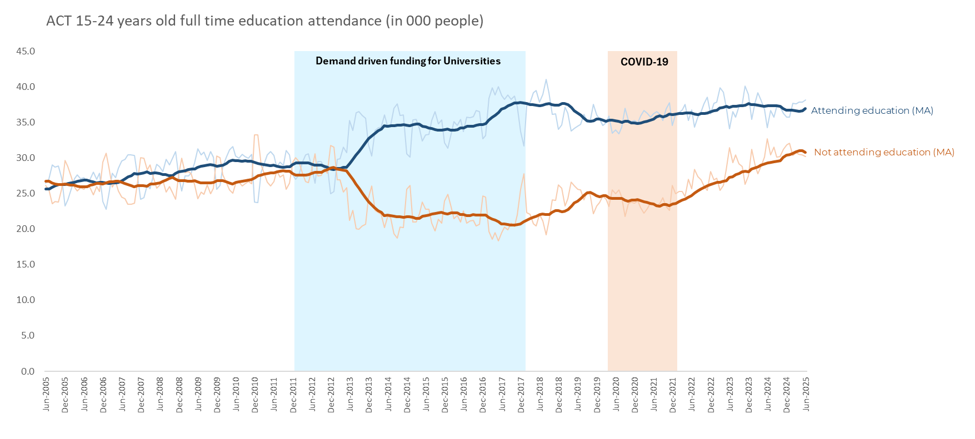
While the number attending education remains stable, the number not attending education has steadily increased
The number not attending education has increased by one-third since 2021
Source: 6291.0.55.001 Labour Force, Australia, Detailed
Table 03. Labour force status for 15-24 year olds by Age, Educational attendance (full-time) and Sex and by State, Territory and Educational attendance (full-time)

Slide 15
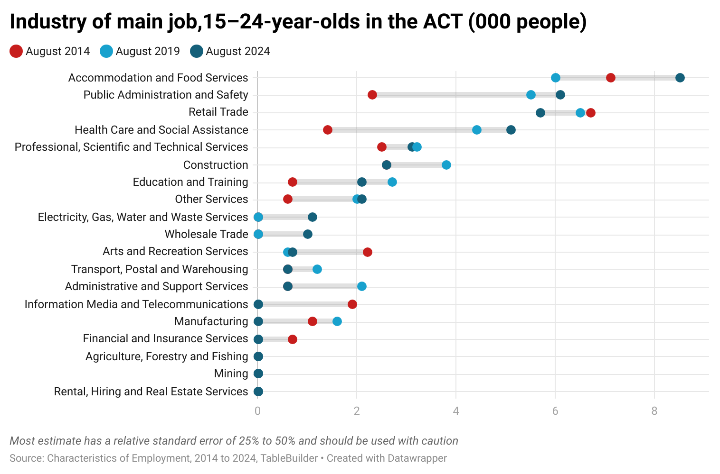
Where do they work?
Hospitality and retail remain common for young workers, but health care and government roles are increasingly popular

Slide 16
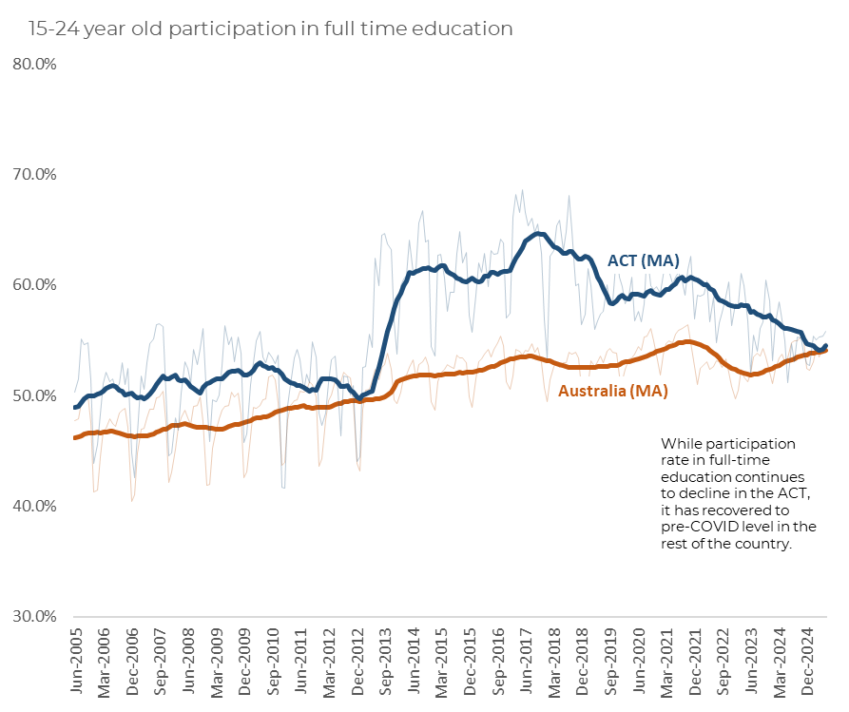
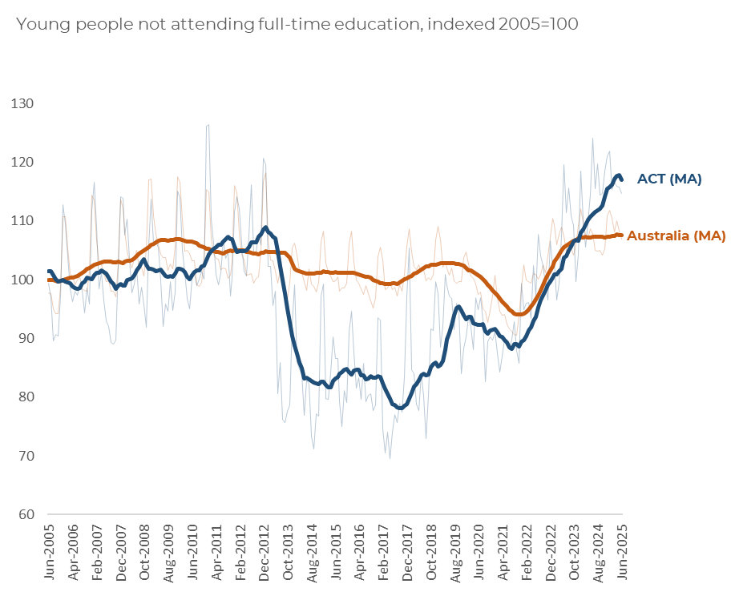
The drop in full-time education participation is more pronounced in the ACT than nationally
Since 2005, the number of ACT youth not in full-time education has increased by 17 per cent.
Nationally, the increase was just 8 per cent.
Source: 6291.0.55.001 Labour Force, Australia, Detailed
Table 03. Labour force status for 15-24 year olds by Age, Educational attendance (full-time) and Sex and by State, Territory and Educational attendance (full-time)

Slide 17
National Skills Agreement
Skye Turner
Senior Director, Skills Projects and Reporting

Slide 18
National Skills Agreement
The NSA focuses on:
  Delivering high quality, responsive, and accessible training,
  Supporting Australians to obtain the skills they need, and
  Ensuring Australia has the skilled workforce needed in critical industries.
  Priority areas include:
  Women’s participation and gender equality,
  Working closely with Aboriginal and Torres Strait Islander communities and training providers to support skills development and career opportunities,
  Supporting TAFE at the centre – including workforce capability, Centres of Excellence and leadership networks,
  Improvements for data and data systems, and
  Digital capability uplift for learners.

Slide 19
ACT Skills Action Plan
Outlines the ACT’s commitment to delivering agreed national priorities, with a focus on local workforce needs.
Sustaining essential care services
Developing Australia’s sovereign capability and food security
Supporting the Net Zero transformation
Delivering housing supply
Ensuring Australia’s digital and technology capabilities
Gender equality
Closing the Gap
Improving the regulation of VET qualifications and quality

Slide 20
National Skills Agreement
Policy Initiatives
    The ACT is progressing eight special policy initiatives under the NSA.
    The ACT was the first jurisdiction to have all implementation plans finalised with the Commonwealth – agreed in October 2025.
    The implementation plans are publicly available on the Federal Financial Relations website:
    https://federalfinancialrelations.gov.au/taxonomy/term/1141

Slide 21
National Skills Agreement
Canberra Institute of Technology
Four policy initiatives will be delivered by the Canberra Institute of Technology
Measures to strengthen the VET workforce
  Growing the skills, capacity and capability of the CIT workforce to address NSA objectives and ensure a future ready workforce.
National TAFE Network
  Establish a National TAFE Network to foster collaboration between the teachers and administrators of public training providers to develop resources, improve the quality of teaching and learning practice, and enhance the status of TAFE.
TAFE Centres of Excellence
  Centres of Excellence will be established to coordinate with industry, universities and governments to grow the future skilled workforce and meet emerging challenges.
      Electric Vehicle
      Cyber Security, with a focus on sovereign capability

Slide 22
National Skills Agreement
ACT Government – Skills Canberra
Skills Canberra has begun to implement all other initiatives.
Enhanced VET Data and Evidence
    Focused on ensuring accurate and timely access to high quality data to measure the achievement of outcomes and support reform within the VET system.
    The ACT is closely engaged with the interjurisdictional working groups.
    The sector will be consulted on draft documents this year.
Closing the Gap
    An initial funding injection to support workforce needs, as well as engagement of an Aboriginal and Torres Strait Islander consultant to form recommendations for shared decision-making frameworks.
    Skills Canberra has begun initial consultation with the Elected Body and Aboriginal Services Development team, and ACT Procurement to progress the actions.

Slide 23
National Skills Agreement
ACT Government – Skills Canberra
Ensuring Access to Foundation Skills Training
    Expansion of the ACT ACE Grants Program and review of foundation skills offerings.
    The 2025-2027 ACE Grant Program was finalised in December. Seven successful projects will commence this month – further information on Skills Canberra website
Improved Completions – Especially for Priority Groups
    To further understand and address non-completion in the ACT..
      Establishment of a Completions Grants program – the first round is expected to open in coming months. Program aims are under development but likely to focus on supporting learners to complete training and transition successfully into meaningful employment.
      Establishment of a Careers Hub in the ACT – to improve alignment between learner ambitions and course choice and training pathways. Procurement will be undertaken to inform recommendations about Hub establishment and needs.
      Establishment of a free text message support service for ACT VET students – to check in with learners at key points in their training journey and connect them with resources and support.
      Further completions research in the ACT context – to evaluate and refine completions initiatives, build the national evidence base and share best-practice knowledge and case studies.

Slide 24
Qualification Reform
    Skills Ministers agreed qualification reform would be embedded in the Training Package Organising Framework in December 2024.
    Reforms aim to support:
      Enhanced responsiveness to change
      High-performing, simple and user-centric
      Safety and quality
      Resilient and adaptable skilled workforce
      Uptake in nationally recognised training
    As of October 2025, there were 73 active training package development projects, with 63 using the updated 2025 TPOF templates.
    Skills Canberra understands these reforms can see administrative impacts on your organisations. We continue to advocate for you in national forums, to stress that reforms should be streamlined and introduced in a way that considers RTO capacity.

Slide 25
Qualification Reform
How?
Ten Jobs and Skills Councils - https://www.dewr.gov.au/skills-reform/jobs-and-skills-councils
Peak bodies and stakeholders fostering reform values and sharing best practices.
Early engagement and more agile delivery models of new and revised qualifications.
Review and update internal STA processes to support faster uptake.
Implementation
Strategic Industry Advisory Committee (SIAC)
Jobs and Skills Councils (JSC) led Quality Qualification working group (JSC WG)
JSCs adopting the new approach under the TPOF in tandem with industry needs and priorities
Release of The National Training Register (NTR) website at training.gov.au

Slide 26
Questions?
General skills enquiries: skills@act.gov.au
Email: skills.projects@act.gov.au if you would like further information or to share your ideas.
Subscribe: Join the Skills Canberra email newsletter to stay updated on consultations and grant opportunities.
Talk to us today: Officers are available at the Policy Table for clarification or discussion.

Slide 27
Training Awards
Elodie Auvray
Event and Engagement Manager

Slide 28
Training Awards
ACT and Australian Training Awards Journey
With Jiwon Kwack
2025 ACT Trainee of the year winner and ATA finalist.
and Stewart McLeod
2025 ACT Apprentice of the year winner and ATA finalist.

Slide 29
2026 ACT Training Awards
Key dates
  Nominations: Wednesday 25 February - Tuesday 21 April 2026
  Interviews: Monday 29 June to Friday 2 July 2026
  Presentation event: Thursday 3 September 2026
Category targets
  Student categories
  small and large Registered Training Organisations
  small and large Employers
  John Scott and Norm Fisher
Sponsorship

Slide 30
Paperwork, Payments and Pitfalls
Anita Dolstra
Senior Director, Skills Program Operations and Support

Slide 31
Agenda & Timings
Objectives — 2 min
How we’ll engage today — 2 min
Compliance Guide review — 6 min
BSSS rules for ASBA units — 7 min
ACT vs NSW training contract — 4 min
Training Plans & Record Books — 4 min
Payments & procedures — 3 min
Wrap‑up & transition — 2 min
Breakout Q&A — 30 min

Slide 32
Session outcomes
Understand key focus areas for 2026
Know where to find guidance and what’s coming next
Leave with clear actions and a way to nominate workshop topics

Slide 33
How we’ll run today
Presentation (≈30 minutes) → Breakout conversations (≈30 minutes)
Staffed tables: ask questions, get answers or a follow‑up booked
We’ll also point you to existing resources where helpful

Slide 34
How to nominate topics
Suggest workshop topics to staff at tables
Complete anonymous post‑forum survey (tick as many topics as you like)
Workshops cadence: about every 2 months, online
We’ll publish dates and registration via Skills Canberra news
Notes:
Encourage immediate and survey‑based input.

Slide 35
Today’s topics overview
Compliance Guide for Australian Apprenticeships — revision focus
BSSS rules for ASBA units counting towards the ACT SSC
ACT vs NSW: determining the right training contract
Training Plans & Training Record Books — compliance essentials
Payments & procedures — where to get help
Notes:
Map the journey for the audience.

Slide 36
Compliance Guide — context & objectives
New revision is in progress
No change to policy intent — no new rules
Focus on simplifying and streamlining while maintaining compliance
Notes:
Reassure and set scope.

Slide 37
Compliance Guide —simplifying
Clearer wording where possible to aid interpretation
Example area: Training Contract suspension rules
Aim: make requirements easier to read and apply (no change to what RTOs must do)
Notes:
Concrete examples of ‘simplifying’.

Slide 38
Compliance Guide — streamlining
Lighter processes where feasible without reducing assurance
Example: Additional Support Funding process for extra group tutorials
Aim: faster reporting/approval while keeping compliance intact
Notes:
Illustrate process efficiency, not policy change.

Slide 39
Compliance Guide — what to expect next
Skills Canberra news item will announce publication
An online workshop will walk through the revisions with RTOs and stakeholders
Bring your operational questions to that session
Notes:
Flag comms channel + engagement point.

Slide 40
BSSS rules for ASBA units — snapshot
Only completed UoCs count towards the ACT Senior Secondary Certificate (SSC)
BSSS relies on AVETARS records to confirm completed UoCs
There is a deadline for UoCs to be counted (Year 12 timeline)
UoCs completed in Year 10 and Credit Transfer do not count
E‑units are based on nominal hours: 1.0 E = 100 nominal hours (see Victorian training package purchasing guides | vic.gov.au )
Notes:
List the rules succinctly.

Slide 41
BSSS E‑unit calculation — example
HLTWHS001 — 20 nominal hours
SISOFLD001 — 30 nominal hours
Total = 50 hours ⇒ 0.5 BSSS E‑units
Notes:
Walk through the maths to solidify understanding.

Slide 42
BSSS changes — why this matters
Schools are concerned uptake of ASBAs could drop due to counting rules
RTO decisions on sequencing, reporting, and communication can help mitigate this
Notes:
Create relevance and urgency.

Slide 43
What RTOs can do to help
Plan Training Plans with the SSC in mind
Report completed UoCs in AVETARS by 31 Oct of Year 12
Remember: Year 10 UoCs won’t count towards the SSC
Report completions promptly to help students plan ahead
Keep Training Plans up‑to‑date; share with school (with permissions)
Notes:
Convert concern into actionable steps.

Slide 44
ACT or NSW training contract — the rule
Jurisdiction is determined by the apprentice/trainee’s actual workplace location
Relevance: key for RTOs without access to NSW training subsidies
Notes:
Anchor the determinant simply and clearly.

Slide 45
ACT vs NSW — scenarios
Multi‑site employers: use the primary workplace for the apprentice
Remote or mobile work: confirm the base workplace location
GTOs: provide first host employer’s workplace location
Notes:
Pre‑empt common edge cases.

Slide 46
ACT vs NSW — support materials
Two fact sheets drafted to help employers to provide the correct workplace details on training contracts
We’ll notify you via a news item when they’re published
Two versions:
  employers in general
  GTOs
Notes:
Point to upcoming guidance and comms.

Slide 47
Training Plans & Training Record Books
Audit lens
These are always reviewed during a Skills Canberra RTO audit
Employer compliance lens
In 2026, Field Officers will renew focus on checking these during employer visits
In summary
Ensure documents are current, accurate, and available
Notes:
Signal scrutiny so providers prepare.

Slide 48
Training Plans — pitfalls & fixes
Training plan is not kept up to date
Why: Out‑of‑date plan → misaligned training
Fix: Review and update the plan whenever changes occur (e.g., unit changes, employer changes, delivery mode changes); reissue to all parties, and ensure the plan is reviewed and updated at least once every 12 months — retain evidence
Training plan is incomplete
Why: Invalid plan; key components missing
Fix: Ensure all required fields are completed, including units, timelines, responsibilities, signatures, and training arrangements
Employer does not recall having a training plan or negotiating it
Why: Employer not engaged → training may not meet workplace requirements
Fix: Re‑engage the employer, explain their role, review the plan with them, and obtain proper acknowledgement
Notes:
Use each tile as a mini case: pitfall, quick risk, concrete fix. Invite providers to check their current templates.

Slide 49
Training Record Books — pitfalls & fixes
Training record book (or equivalent) not provided on or before commencement
Why: AA can begin recording learning from day one; gives AA and employer guidance on workplace tasks to be undertaken
Fix: Issue the record book (or equivalent) before training starts, confirm receipt/access in writing and retain evidence, and brief both the apprentice/trainee and employer on their obligations
Training record book (or equivalent) does not meet ACT requirements
Why: Missing/unclear info → hard to show progress, support learning, or assess
Fix: Identify what information is missing, update the documentation so all ACT‑required elements are included, ensure the information is captured clearly (in one document or across several), and reissue the corrected version to all parties
Notes:
Highlight day-one setup and ACT content requirements; emphasise confirming access in writing and reissuing corrected versions.

Slide 50
Payments & procedures — how to get help
Bring questions to the VETPO team table during the Q&A session
If complex, we’ll investigate and get back to you
We can also connect you to relevant guidance and contacts
Notes:
Encourage engagement without over‑promising.

Slide 51
Payments — common pitfalls & tips
Notes:
High‑value prompts for discussion.

Slide 52
Payments — common pitfalls & tips (cont.)
Timing mismatches between activity and claims
Fix: make sure you understand all the timing rules for payments in the compliance guide
Uploading a payable outcome in NAT file, then later uploading another file that changes it to a non‑payable outcome, reversing the payment.
Fix:always check your files before you upload (extra tip: using a checklist can help).
Missing out on payments for completed qualifications
Fix: Make sure you upload units before recording a ‘Completed’ training contract, as AVETARS does not allow for unit payment claims to be uploaded on a Completed training contract.
Notes:
High‑value prompts for discussion.

Slide 53
Payments — common pitfalls & tips (cont.)
Pitfall: Timing mismatches between activity and payment claims
E.g.:
submitting a claim before the training contract is approved
submitting after the 8‑week window
recording unit result dates outside the contract period.
Why it matters
Claims are automatically rejected when timing rules aren’t met, and late or incorrectly‑timed submissions can’t be paid without prior approval.
Fix
Make sure you understand all timing rules for payments in the Compliance Guide and always check contract status and key dates before claiming.
Extra tip: if unsure, always email skills@act.gov.au for advice or permission, before you act.
Notes:
High‑value prompts for discussion.

Slide 54
Q&A session — tables overview
System Design & Analysis table — AVETARS questions
Compliance & Performance or VET Program Operations table — compliance, funding, eligibility & payments
Field Officer Program table — employer/apprentice case support
Notes:
Help attendees choose the right table.

Slide 55
Thank you / Q&A
You can move to breakout tables now
Please fill in the survey and keep in touch via skills@act.gov.au
We appreciate your feedback and ideas
Notes:
Close strong and invite engagement.

Slide 56
Questions?
Key contacts:
Skilled Capital and grants – skills.projects@act.gov.au
General skills enquiries – skills@act.gov.au

