Slide 1





THE HUMAN SERVICES
COSTING & PRICING
RESOURCE PACKAGE
Training Video 1: Introduction
Professor David Gilchrist,
Director, UWA Centre for Public Value

Slide 2



Agenda
Who we are
The Project Context
The Project Principles
The Project Outputs
The Training Videos
Navigating the Videos
Key ideas

Slide 3
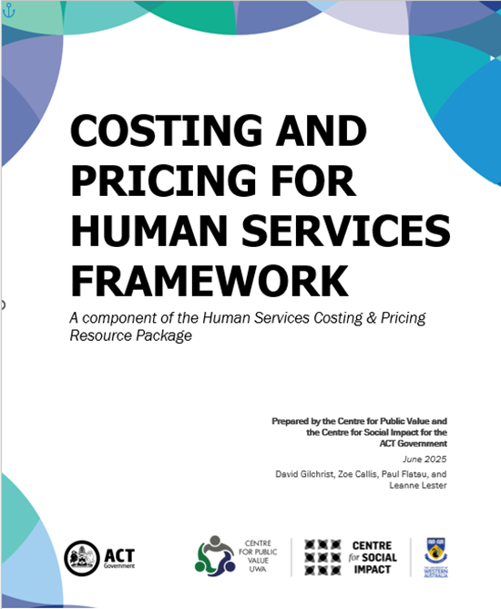
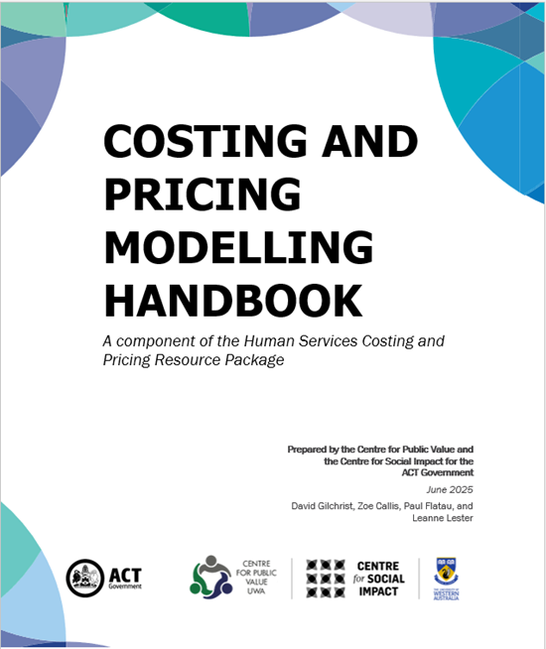
Who we are
UWA Centre for Public Value
Centre for Social Impact UWA
Significant background in undertaking similar projects nationally and sub-nationally:
  Costing & Pricing
  Indexation
  Tool Creation

Slide 4
The Project Context
Funded by the ACT Government
Challenge to sustainability is ever increasing at a systemic and organisational level
Historical under-funding across all governments and all times so that underinvestment is embedded
The first step in rectifying this issue is to properly cost the delivery of services
This requires an understanding of costing processes and what constitutes the quality, quantity and timing requirements of sustainability.
SPRC Report 2021 Counting the Costs: Sustainable funding for the ACT community services sector and ACT Government Response 2023

Slide 5
The Project Principles
Governments, Philanthropists and Human Services Providers all want a sustainable human services sector
Governments, Philanthropists and Human Services Providers want public funds to be efficiently and effectively used in the interests of the entire community
Tools need to be fit-for-purpose
Collaboration between Governments, Human Service Providers and Philanthropists is a critical element in ensuring the long-term sustainability of Human Services delivery
These resources provide a common language between funders and fundees.

Slide 6
The Project Tools
Costing and Pricing for Human Services Framework
The Service Provider Costing & Pricing Model (an MS Excel Spreadsheet Tool – to cost the organisation)
The Single Product Costing & Pricing Model (an MS Excel Spreadsheet Tool – to cost a particular program)
The Costing & Pricing Provider Training Videos (4 Videos)
The Costing & Pricing Government Procurement Training Video

Slide 7
The Training Videos
Video 1 – Introduction
Video 2 – Costing & Pricing Governance
Video 3 – Costing & Pricing Principles
Video 4 – The MS Excel Costing Models
Video 5 – Costing & Government Procurement Training Video
Educational Resources
Aim to lift financial literacy

Slide 8
Navigating the Videos
Start at the very beginning & watch in order
Read the Framework document prior to watching videos 3 & 4
The videos include navigation markers to help connect the training with the outputs:
Reference to Framework page 20
Reference to Handbook page 20
FW 20
HB 20

Slide 9

Some Key Elements
The Costing & Pricing For Human Services Framework
Using the Framework
Glossary
Questions Boards Should Ask
Appendix
FW 4
FW 10
e.g. FW 26
FW 46

Slide 10

Some Key Elements (cont.)
The Costing & Pricing Modelling Handbook
Using the Handbook
Minimum IT Specifications
Glossary
Costing & Pricing Principles
Navigating the Models
HB 5
HB 5
HB 6
HB 18
HB 24

Slide 11
Objectives here…
Increase financial literacy of funders and fundees
Increase financial decision-making capacity
Increase mutual understanding between funders and fundees
Increase financial sustainability in the short-, medium- and longer-terms
Increase policy response capacity
Increase efficiency and effectiveness of human services delivery
What the tools cannot do…
Undertake the costing and pricing for you
Determine whether or not an offered price from a funder is appropriate
Forecast what economic and/or policy conditions may lie ahead
Inform funder budgets

Slide 12
Thank you!
Professor David Gilchrist david.gilchrist@uwa.edu.au
Professor Paul Flatau paul.flatau@uwa.edu.au
UWA Centre for Public Value Website:
https://www.uwa.edu.au/schools/Research/Centre-for-Public-Value
Centre for Social Impact UWA Website:
https://www.uwa.edu.au/schools/research/UWA-Centre-for-Social-Impact

